Slide 1
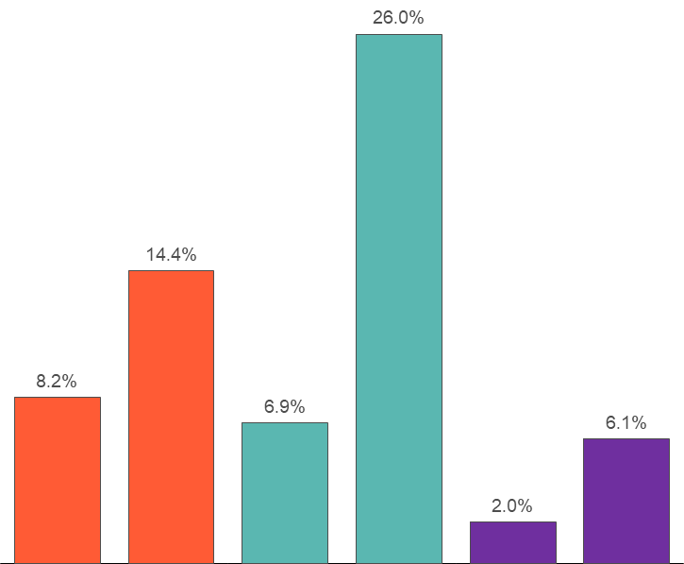
Q3 2025 Market Review
SUMMARY
TRAILING RETURNS (9/30/2025)
Global Equity markets once again posted strong returns over the quarter aided by both U.S. and International markets. Fixed income markets were also positive over the quarter.
U.S. equities returned 8.2% (Russell 3000) with Information Technology and Telecommunication Services as the best performing sectors and Consumer Staples as the worst and only negative returning sector. Small caps outperformed large caps over the quarter led by small cap value which was up 12.6% (Russell 2000 Value). Large cap growth continued its strong run outperforming large cap value by about 520 basis points (10.5% for Russell 1000 Growth vs. 5.3% for Russell 1000 Value).
International equities and Emerging Markets equities performed well over the quarter, returning 4.8% (MSCI EAFE) and 10.6% (MSCI Emerging Markets), respectively.
The broad U.S. fixed income market returned 2.0% (Bloomberg Barclays Aggregate) over the quarter as the Fed cut the Fed Funds Rate by 25 basis points in September. Over the past year, rate cuts combined with long term rates rising has caused the yield curve to steepen. The 10- year treasury rate remained largely unchanged from the previous quarter end.
Quarterly and year-to-date returns of the following indices: U.S. Equity (Russell 3000 Index), Fixed Income (Bloomberg Barclays U.S. Aggregate Bond Index) and International Equity (MSCI ACWI ex U.S. Index)

Slide 2
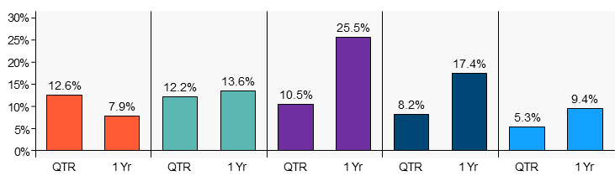
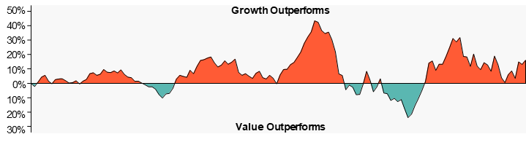
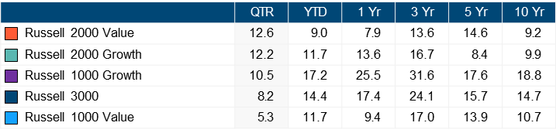
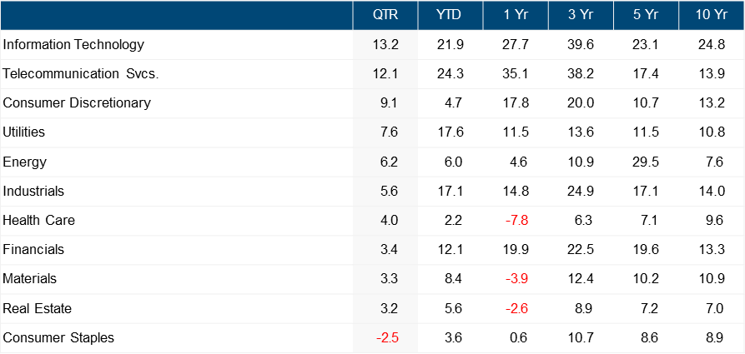
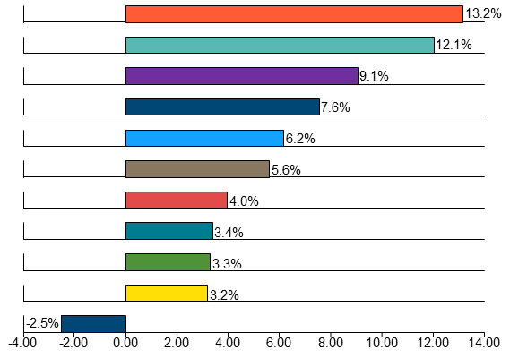
Q3 2025 Market Review – U.S. Equity
U.S. EQUITY
The broad U.S. equity market, as measured by the Russell 3000 Index, was up 8.2% for the quarter.
The best performing U.S. equity index for the quarter was Russell 2000 Value, returning a positive 12.6%.
The worst performing U.S. equity index for the quarter was Russell 1000 Value, returning a positive 5.3%.
INDEX PERFORMANCE (sorted by trailing quarterly performance)
GROWTH VS. VALUE
Over the last year, growth stocks outperformed value stocks by 16.10%.
For the trailing quarter, growth stocks outperformed value stocks by 5.20%.
The graph above is plotted using a rolling one-year time period.
Growth stock performance is represented by the Russell 1000 Growth Index.
Value stock performance is represented by the Russell 1000 Value Index.
SECTOR (sorted by trailing quarterly performance)
Source: S&P 1500 Sector Indices

Slide 3
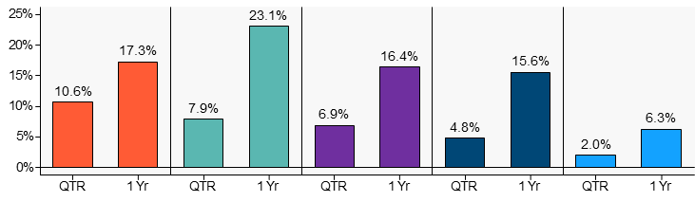
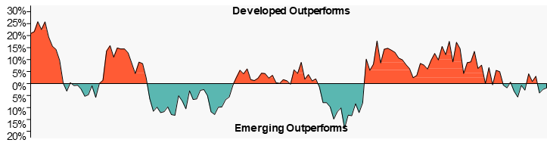
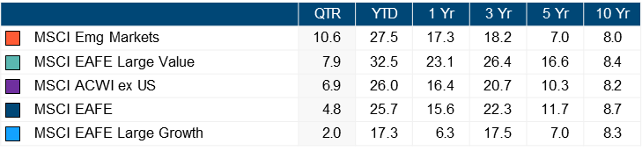
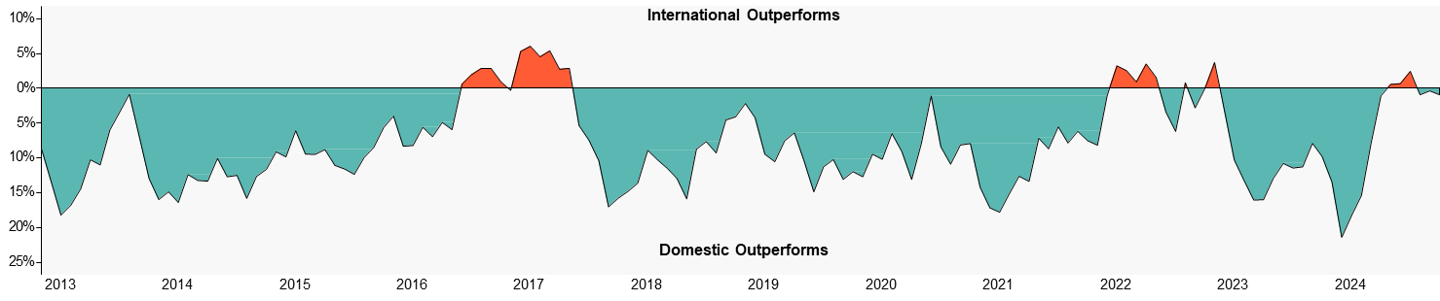
Q3 2025 Market Review – International Equity
INTERNATIONAL EQUITY
Developed international equity returned a positive 4.8% in the last quarter (MSCI EAFE).
Emerging market equity posted a positive 10.6% return (MSCI Emerging Markets Index).
INDEX PERFORMANCE (sorted by trailing quarterly performance)
DEVELOPED VS. EMERGING MARKETS
Over the last year, emerging market stocks outperformed developed international stocks by 1.70%.
For the trailing quarter, emerging market stocks outperformed developed international stocks by 5.80%.
The graph above is plotted using a rolling one-year time period. Developed international stock performance is represented by the MSCI EAFE Index. Emerging market stock performance is represented by the MSCI Emerging Markets Index.
INTERNATIONAL VS. DOMESTIC
The graph above is plotted using a rolling one-year time period. International stock performance is represented by the MSCI ACWI ex U.S. Index. Domestic stock performance is represented by the Russell 3000 Index.

Slide 4
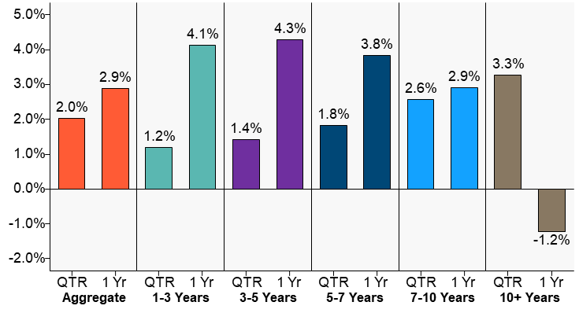
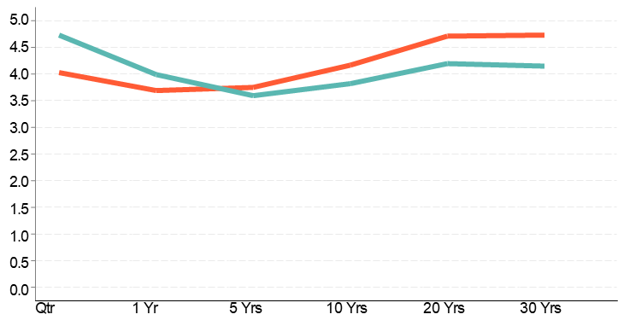
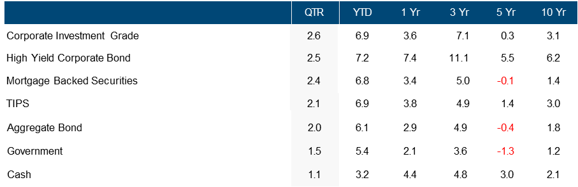
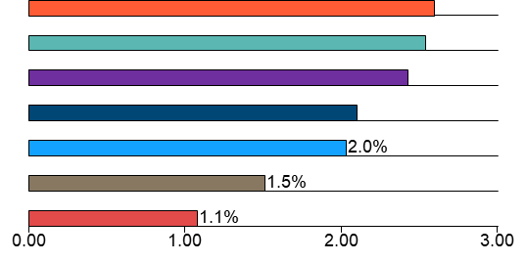
Q3 2025 Market Review – Fixed Income
FIXED INCOME
The broad U.S. fixed income market returned a positive 2% (Bloomberg Barclays U.S. Aggregate) for the quarter.
The best performing sector for the quarter was Corporate Investment Grade, returning a positive 2.6%.
The worst performing sector for the quarter was Cash, returning a positive 1.1%.
PERFORMANCE BY MATURITY
YIELD CURVE
Source: Bloomberg Barclays U.S. Aggregate Indices
SECTOR (sorted by trailing quarterly performance)
2.6%
2.5%
2.4%
2.1%
Source: Bloomberg Barclays U.S. Indices

Slide 5
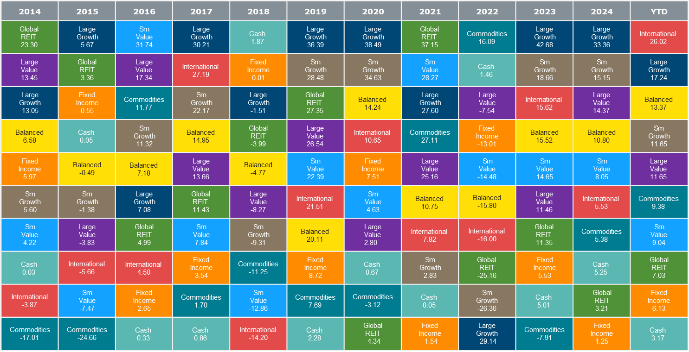
Q3 2025 Market Kaleidoscope
ASSET CLASS RETURNS
The following chart exhibits the volatility of asset class returns from year to year by ranking indices in order of performance, highlighting the importance of diversification.

Slide 6
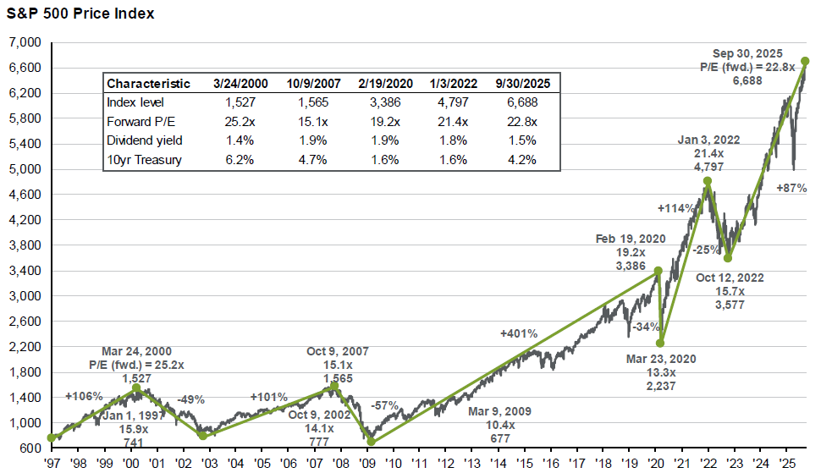
Q3 2025 Market Review – Chart of the Quarter
Soaring Stock Market
Over the third quarter, the S&P 500 Index continued to move higher as the stock market reached all time highs in September. Since the beginning of the year, the index has hit 28 new daily all time highs. In the period since October 2022, after inflationary pressures had caused a sharp decline in the markets, the index has rebounded 87%. As seen in the chart below, the S&P 500 is also trading at about 23 times forward earnings which is above the valuation of the market at the start of 2022 and just shy of the 25 times the market was trading at prior to the tech bubble collapse of the early 2000s. While the elevated valuation isn't necessarily an indicator of immediate trouble, valuation has been a fairly good indicator of subsequent market returns looking over longer periods. This serves as a good reminder for investors to continue to maintain a diversified asset allocation as market euphoria can end abruptly as it did recently in 2020 and 2022.
Source: FactSet, Federal Reserve, Refinitiv Datastream, Standard & Poor’s, J.P. Morgan Asset Management.
Dividend yield is calculated as consensus analyst estimates of dividends in the next 12 months, provided by FactSet, divided by the most recent S&P 500 index price. Forward P/E ratio is the most recent S&P 500 index price divided by consensus estimates for earnings in the next 12 months, provided by IBES since January 1997 and FactSet since January 2022. Returns are cumulative and do not include the reinvestment of dividends. Guide to the Markets – U.S. Data are as of September 30, 2025.

Slide 7
Q3 2025 Disclosures
Performance of indexes reflects the unmanaged result for the market segment the selected stocks represent. Indexes are unmanaged and not available for direct investment.
Citigroup Corporate Bond is an index which serves as a benchmark for corporate bond performance. You cannot invest directly in an index.
Citigroup Mortgage Master is an index which serves as a benchmark for U.S. mortgage-backed securities performance.
Citigroup WGBI Index is an index which serves as a benchmark for global bond performance, including 22 different government bond markets.
Credit Suisse High Yield Index is an unmanaged, trader priced index constructed to mirror the characteristics of the high yield bond market.
BC (Barclays Capital) U.S. Aggregate Bond Index represents securities that are U.S., domestic, taxable, and dollar dominated. The index covers the U.S. investment grade fixed rate bond market, with index components for government and corporate securities, mortgage pass-through securities, and asset-backed securities. These major sectors are subdivided into more specific indices that are calculated and reported on a regular basis.
BC Credit Bond Index includes publicly issued U.S. corporate and specified foreign debentures and secured notes that meet the specified maturity, liquidity, and quality requirements. To qualify, bonds must be SEC-registered.
BC U.S. Corporate Investment Grade represents investment grade corporate securities that are U.S., domestic, taxable, and dollar denominated.
BC High Yield Corporate Bond represents below investment grade corporate securities that are U.D., domestic, taxable, and dollar denominated.
BC TIPS Index includes publicly issued U.S. government treasury inflation protected securities that meet the specified maturity, liquidity and other requirements.
BC Mortgage-Backed Securities covers agency mortgage-backed pass-through securities (both fixed-rate and hybrid ARMs) issued by Ginnie Mae (GNMA), Fannie Mae (FNMA), and Freddie Mac (FHLMC).
BC Muni Bond covers the USD-denominated long-term tax-exempt bond market with four main sectors: state and local general obligation bonds, revenue bonds, insured bonds, and pre-refunded bonds.
BC Government Index includes publicly issued U.S. government securities that meet the specified maturity, liquidity and other requirements.
BarCap U.S. Aggregate 1-3 Yr. TR USD Index represents securities in the BC U.S.
Aggregate Index that have maturity dates over the next 1-3 years.
BarCap U.S. Aggregate 3-5 Yr. TR USD Index represents securities in the BC U.S. Aggregate Index that have maturity dates over the next 3-5 years.
BarCap U.S. Aggregate 5-7 Yr. TR USD Index represents securities in the BC U.S. Aggregate Index that have maturity dates over the next 5-7 years.
BarCap U.S. Aggregate 7-10 Yr. TR USD Index represents securities in the BC U.S. Aggregate Index that have maturity dates over the next 7-10 years.
BarCap U.S. Aggregate 10+ Yr. TR USD Index represents securities in the BC U.S. Aggregate Index that have maturity dates over 10 years.
DJW 5000 (Full Cap) Index measures the performance of all U.S. common equity securities, and serves as an index of all stock trades in the U.S.
MSCI FI Emerging Markets is a rules-based index which serves as a benchmark for emerging country fixed income performance.
MSCI FI EAFE International is a rules-based index which serves as a benchmark for developed international country fixed income performance.
MSCI EAFE Index is listed for foreign stock funds (EAFE refers to Europe, Australia and Far East). Widely accepted as a benchmark for international stock performance, it is an aggregate of 21 individual country indexes.
MSCI EAFE Large Value represents the large cap value stocks within the MSCI EAFE Index.
MSCI EAFE Large Growth represents the large cap growth stocks within the MSCI EAFE Index.
MSCI EAFE Mid Value represents the mid cap value stocks within the MSCI EAFE Index.
MSCI EAFE Mid Growth represents the mid cap growth stocks within the MSCI EAFE Index.
MSCI EAFE Small Value represents the small cap value stocks within the MSCI EAFE Index.
MSCI EAFE Small Growth represents the small cap growth stocks within the MSCI EAFE Index.
MSCI EM (Emerging Markets) Index serves as a benchmark for each emerging country. The average size of these companies is (U.S.) $400 million, as compared with $300 billion for those companies in the World index.
MSCI World Index is a rules-based index that serves as a benchmark for the developed global equity markets.
MSCI Europe ex UK Index is a rules-based index that serves as a benchmark for Europe’s equity markets, excluding the United Kingdom.
MSCI Pacific ex Japan Index is a rules-based index that serves as a benchmark for Asia Pacific’s equity markets, excluding Japan.
MSCI United Kingdom Index is a rules-based index that serves as a benchmark for the United Kingdom’s equity markets.
MSCI Japan is a rules-based index that serves as a benchmark for Japan’s equity markets.
NAREIT AII REIT Index includes all tax-qualified REITs with common shares that trade on the New York Stock Exchange the American Stock Exchange or the NASDAQ National Market List.
3-Month T-Bills (90 Day T-Bill Index) are government-backed, short-term investments considered to be risk-free and as good as cash because the maturity is only three months.
Russell 1000 Growth Index is a market-capitalization weighted index of those firms in the Russell 1000 with higher price-to-book ratios and higher forecasted growth values.
Russell 1000 Value Index is a market-capitalization weighted index of those firms in the Russell 1000 with lower price-to-book ratios and lower forecasted growth values.
Russell Top 200 Growth Index is a market-capitalization weighted index of those firms in the Russell Top 200 with higher price-to-book ratios and higher forecasted growth values.
Russell Top 200 Value Index is a market-capitalization weighted index of those firms in the Russell Top 200 with lower price-to-book ratios and lower forecasted growth values.
Russell 2000 Growth Index is a market-weighted total return index that measures the performance of companies within the Russell 2000 Index having higher price-to-book ratio and higher forecasted growth values.
Russell 2000 Index consists of the smallest 2000 companies in the Russell 3000 Index, representing approximately 7% of the Russell 3000 total market capitalization.
Russell 2000 Value Index is a market-weighted total return index that measures the performance of companies within the Russell 2000 Index having lower price-to-book ratio and lower forecasted growth values.

Slide 8
Q3 2025 Disclosures
Russell MidCap Growth Index is a market-weighted total return index that measures the performance of companies within the Russell MidCap Index having higher price-to-book ratio and higher forecasted growth values.
Russell MidCap Index includes firms 201 through 1000, based on market capitalization, from the Russell 3000 Index.
Russell MidCap Value Index is a market-weighted total return index that measures the performance of companies within the Russell MidCap Index having lower price-to-book ratio and lower forecasted growth values.
Russell Top 200 Index consists of the 200 largest securities in the Russell 3000 Index.
Russell 3000 Index is a market capitalization weighted index, consisting of 3,000 U.S. common equity securities, reflective of the broad U.S. equity market.
Salomon 1-10 Yr. Governments is an index which serves as a benchmark for U.S. Government bonds with maturities ranging from 1 to 10 years.
S&P 500 Index measures the performance of the largest 500 U.S. common equity securities, and serves as an index of large cap stocks traded in the U.S.
S&P 1500 Energy Index measures the performance of the energy sector in the S&P
1500 Index.
S&P 1500 Industrials measures the performance of the industrial sector in the S&P
1500 Index.
S&P 1500 Financials measures the performance of the financials sector in the S&P
1500 Index.
S&P 1500 Utilities measures the performance of the utilities sector in the S&P 1500 Index.
S&P 1500 Consumer Discretionary Index measures the performance of the consumer discretionary sector in the S&P 1500 Index.
S&P 1500 Consumer Staples Index measures the performance of the consumer staples sector in the S&P 1500 Index.
S&P 1500 Information Technology measures the performance of the information technology sector in the S&P 1500 Index.
S&P 1500 Materials measures the performance of the materials sector in the S&P
1500 Index.
S&P 1500 Health Care measures the performance of the health care sector in the S&P 1500 Index.
S&P 1500 Telecommunications Services Index measures the performance of the telecommunications services sector in the S&P 1500 Index.
General Disclosure
Any reproduction of this information, in whole or in part, is prohibited. The information contained herein has been prepared solely for informational purposes and is not an offer to buy or sell or a solicitation of an offer to buy or sell any security or to participate in any trading strategy. All data presented herein is unaudited, subject to revision by your advisor and is provided solely as a guide to current expectations. This document is only made available to persons of a kind to who may lawfully be promoted.
Market indexes are included in this report only as context reflecting general market results during the period. Your advisor may provide research on funds that are not represented by such market indexes. Accordingly, no representations are made that the performance or volatility of any fund where your advisor provides research will track or reflect any particular index. Market index performance calculations are gross of management fees.
Research/Outlook Disclosure
This document was produced by, and the opinions expressed are those of your advisor as of the date of writing and are subject to change. This research is based on your advisor’s proprietary research and analysis of global markets and investing. The information and/or analysis contained in this material have been compiled or arrived at from sources believed to be reliable, however your advisor does not make any representation as their accuracy or completeness and does not accept liability for any loss arising from the use hereof. Some internally generated information may be considered theoretical in nature and is subject to inherent limitations associated therein. The reader should not assume that any investments in sectors and markets identified or described were or will be profitable. Investing entails risks, including possible loss of principal. The use of tools cannot guarantee performance. Past performance is no guarantee of future results. The information in this material may contain projections or other forward-looking statements regarding future events, targets or expectations, and is only current as of the date indicated. There is no assurance that such events or targets will be achieved and may be significantly different than that shown here. The information in this material, including statements concerning financial market trends, is based on current market conditions, which will fluctuate and may be superseded by subsequent market events or for
other reasons.

